Slide 1

Cancer Diagnosis, Staging & Goals of Therapy
Chemosafe Kenya 2019

Slide 2
Cancer Diagnosis
A diagnostic workup for cancer may include:
–Detailed history and physical examination
–Blood work including tumor markers
–Biopsy
–Radiologic studies

Slide 3
Cancer Diagnosis
An abnormal finding on physical examination, laboratory or radiological examination may be a sign of cancer, but is not definitive
• A biopsy is the surgical removal of a piece of tissue for microscopic examination
• Tissue examination = definitive diagnosis
Tumour is a rumour, tissue is the issue

Slide 4
Biopsy
Biopsy Type | Description
Aspiration Biopsy/Fine Needle Aspiration (FNA) | Aspiration of cells, fragments of tissue, or fluid through a needle
Core biopsy | Obtaining a core of tissue through a specially designed needle
Incisional Biopsy | Removal of a small wedge of tissue from a larger tumor mass
Excisional Biopsy | Removal of the entire suspected tumor tissue

Slide 5
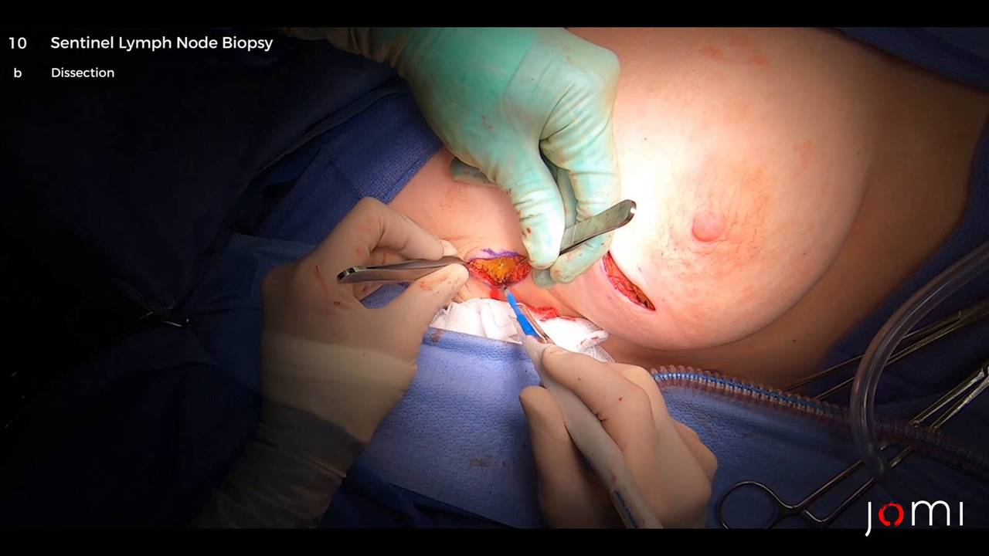
POSTER OF TAKING BIOPSY

Slide 6
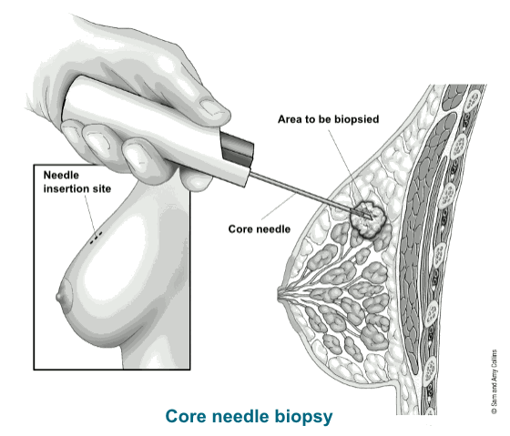

Slide 7
Pathological Diagnosis
Once a biopsy specimen has been taken, cells are examined by a pathologist to determine whether they are normal or cancerous
• Identification includes:
Type of cancer (cell type)
Degree of differentiation
Tumor grade
Staging

Slide 8
Grading and Differentiation
Grading is based on how different cancer cells look from normal cells when viewed under a microscope.
GX | Grade can not be assessed
G1 | Well-differentiated
G2 | Moderately-differentiated
G3 | Poorly-differentiated
G4 | Undifferentiated

Slide 9
Biomarker Testing
Predictive biomarkers
Predict whether or not a patient will respond to a given therapy
– ER/PR, HER2 in breast cancer
– BCL2 in CLL
• Prognostic biomarkers
- Independent measures of prognosis in a patient –PIK3CA tumor mutation HER2–positive metastatic breast cancer

Slide 10
Staging
Used to describe the extent of cancer in the body
• Based on the tumor size and whether the cancer has spread to nearby areas, lymph nodes or distant parts of the body
• TNM – commonly used for solid tumors

Slide 11
Staging
T = TUMOR Size of primary tumor plus extension into local tissue
N = NODES Lymph node involvement
M = METASTASIS Spread to distant location(s)

Slide 12
TNM Staging
• Describes the extent of disease
–Stage I
–Stage II
–Stage III
–Stage IV
• Stage is based on TNM measurement
• Varies by cancer type

Slide 13
TNM Staging: Example
• Breast cancer
T2 – tumor is > 2cm but < 5cm
N1 – cancer has spread to 1-3 axillary lymph nodes
M0 – cancer has not spread to distant organs
Breast cancer stage IIB

Slide 14
Why is staging important?
• To help in treatment planning
• To give prognostic information
• To assist in treatment evaluation

Slide 15
Goals of Cancer Therapy
• Cure
•Control
• Palliation
• Prevention

Slide 16
Treatment Modalities
1. Surgery 2. Radiation 3. Chemotherapy
4.Targeted Therapies 5. Complementary & Alternative Medicine
6.Stem Cell transplant

Slide 17
RESPONSE TO THERAPY Response Evaluation Criteria in Solid Tumours (RECIST)
CR -Disappearance of all target lesions
PR- ≥ 30% decrease in the sum of the longest diameters of target lesions compared with baseline
SD- Persistence of one or more target lesions and/or the maintenance of tumour marker level above the normal limits
PD- ≥ 20% increase in the sum of the longest diameter of target lesions compared with the smallest-sum longest diameter recorded or the appearance of one or more new lesions.
Note—CR = complete response, PR = partial response, PD = progressive disease, SD = stable disease.
AJR:195, August 2010

Slide 18
References
Henke et al., 2011. Cancer nursing : principles and practice. Barbara Holmes Gobel.—7th ed.
Kiambi, M.Z., 2017. Evaluation of Adequacy of Control of Chemotherapy Induced Vomiting in Paediatric Patients With Cancer at Kenyatta National Hospital.
ONS, 2017. Surgery, Radiotherapy and Complementary and Alternative Medicine pdf
Langhorne et al., 2007: Oncology Nursing 5th Edition. Mosby, Inc.,
Varricchio et al., 2004. A Cancer Source Book for Nurses. Jones and Barnett Publishers Inc.
AJR:195, August 2010- Revised RECIST Guideline Version

